Slide 1

Artificial Intelligence (CS-2002)
Chapter 4: Local Search Algorithm and Optimization

Slide 2
Objectives of the Chapter
Local Search: Hill Climbing
• Escaping Local Maxima: Local Beam Search
• Simulated Annealing
• Genetic Algorithm

Slide 3
Local Search
Use single current state and move to the neighboring state.
Idea: Start with an initial guess at a solution and incrementally improve it until it is one.

Slide 4
Hill Climbing Algorithm (Local Search, Greedy Approach, No backtrack)
In this algorithm, we don't need to maintain and handle the search tree or graph as it only keeps a single current state
Hill climbing algorithm continuously moves in the direction of increasing elevation/value to find the peak or best solution to the problem.
It terminates when it reaches a peak value where no neighbor has a higher value.
It is also called greedy local search as it only looks to its good immediate neighbor state and not beyond that.
.

Slide 5
Algorithm
Step 1: Evaluate the initial state, if it is goal state then return success and Stop.
Step 2: Loop Until a solution is found or there is no new operator left to apply.
Step 3: Select and apply an operator to the current state.
Step 4: Check new state:
If it is goal state, then return success and quit.
Else if it is better than the current state then assign new state as a current state.
Else if not better than the current state, then return to step2.
Step 5: Exit.

Slide 6
Example
1 | 2 | 4
5 |  | 7
3 | 6 | 8
1 | 4 | 7
2 | 5 | 8
3 | 6
5
State
goal
5
6
4
5
5
5

Slide 7
Example
Tic-Tac-Toe
Maximum number of winning lines

Slide 8
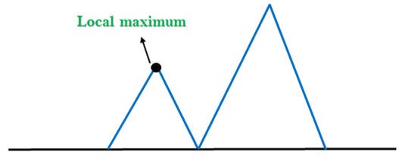
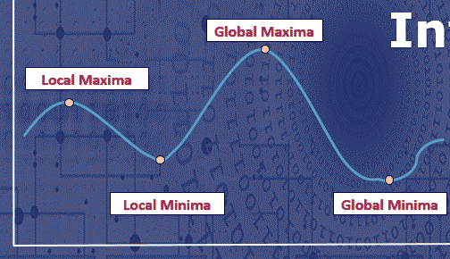
Problems in Hill Climbing
Global maximum
1. Local Maximum: A local maximum is a peak state in the landscape which is better than each of its neighboring states, but there is another state also present which is higher than the local maximum.

Slide 9
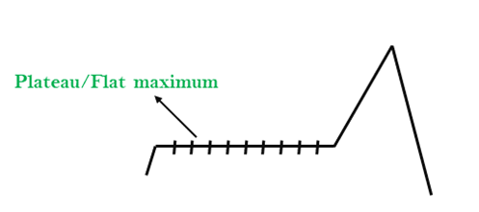
Problems in Hill Climbing….
2 Plateau: A plateau is the flat area of the search space in which all the neighbor states of the current state contains the same value, because of this algorithm does not find any best direction to move. A hill-climbing search might be lost in the plateau area.

Slide 10
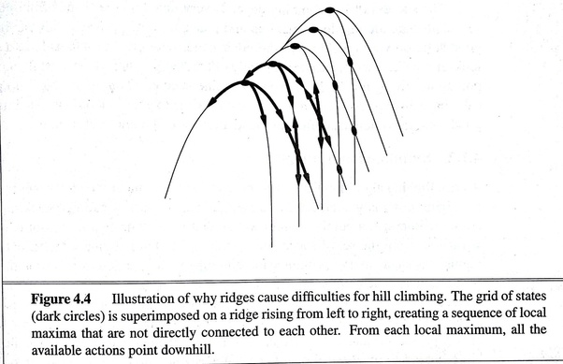
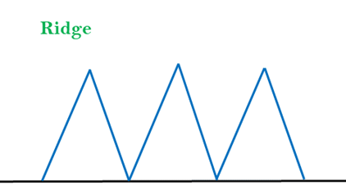
Problems in Hill Climbing…
3. Ridges: A ridge is a special form of the local maximum. It has an area which is higher than its surrounding areas, but itself has a slope, and cannot be reached in a single move.

Slide 11
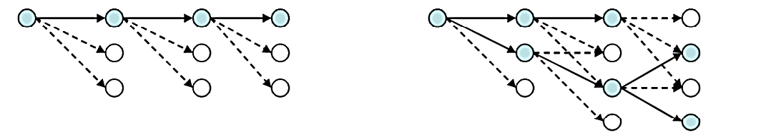
Local Beam Search
Start with k randomly generated states (ß= 2 or 3)
• At each iteration, all the successors of all k states are generated
• If any one is a goal state, stop; else select the k best successors from the complete list and successors from the complete list and repeat
Greedy Local
Local Beam

Slide 12
Simulated Annealing
Conceptually SA exploits an Analogy between Annealing and the Search for a minimum in a more general system
Explore Successors wildly randomly: High temp
As time goes by , explore less wildly: Cool Down
Until there’s a time when things settle: Cold

Slide 13
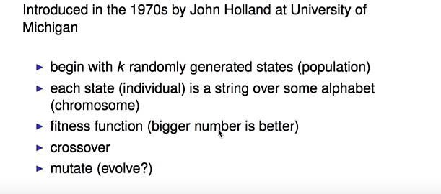
Genetic Algorithm

Slide 14
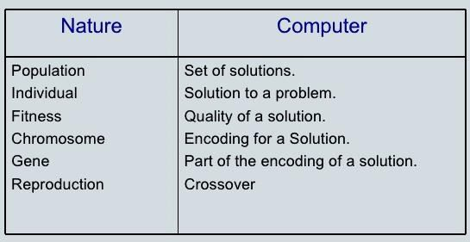
Nature of Computer Mapping

Slide 15
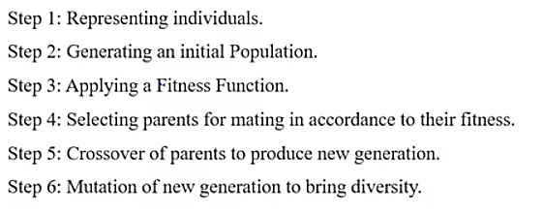
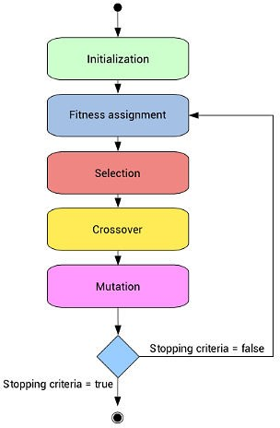
Computational Model

Slide 16
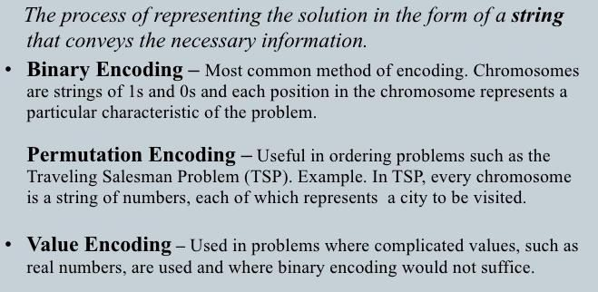
Encoding

Slide 17
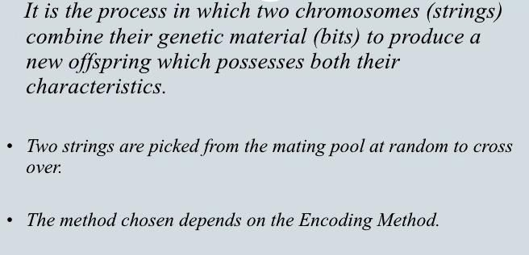
Crossover

Slide 18
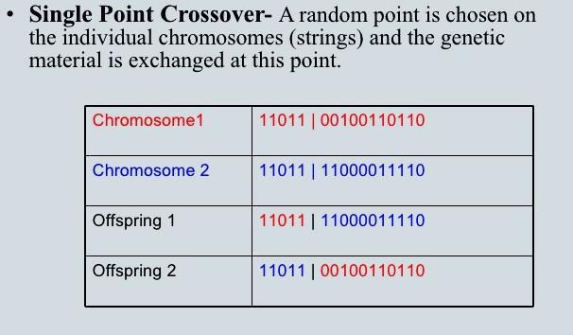
Crossover

Slide 19
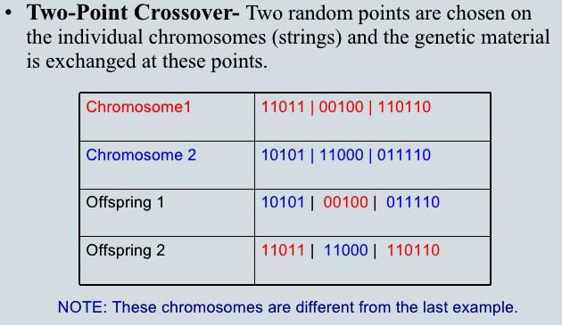
Crossover

Slide 20
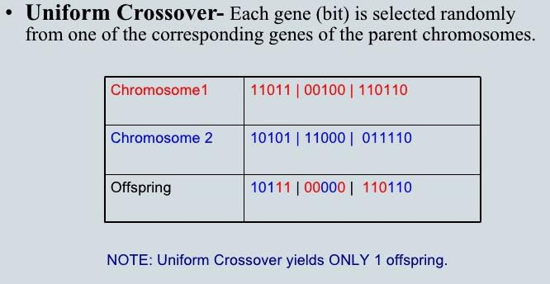
Crossover

Slide 21
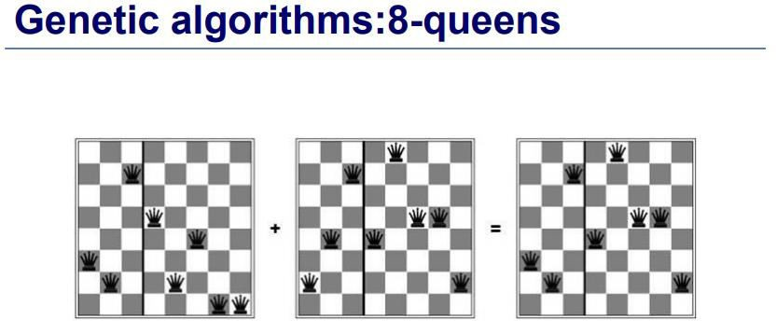

Slide 22
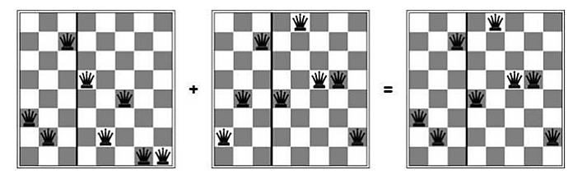
Genetic Algorithm
Fitness function= Pair of non-attacking queens
That way higher scores are better
23 fitness
24748552
string

Slide 23
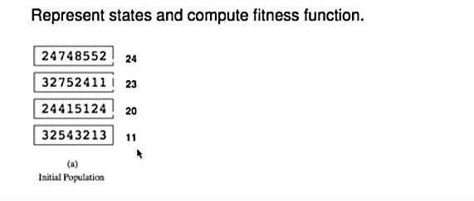
Fitness function
Probability= 24+23+20+11= 78

Slide 24
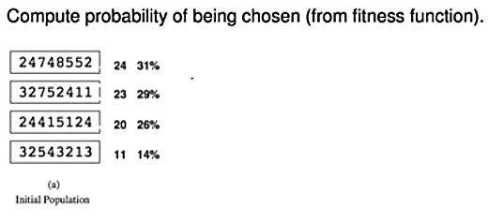
Probability
24/78= 0.307 Normalize 0.307× 100 = 30.7%
chance of being chosen probably

Slide 25
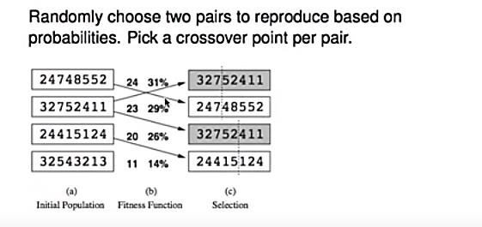
Reproduction

Slide 26
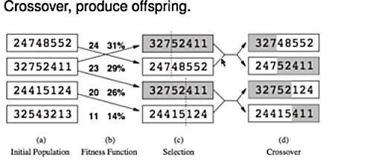
Crossover

Slide 27
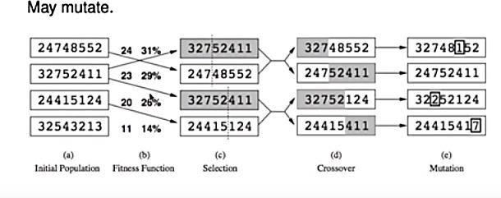
Mutation

Slide 28
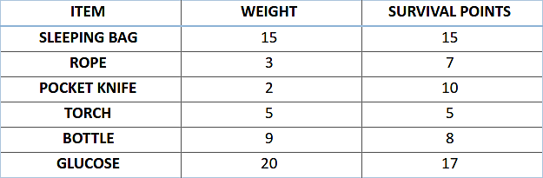
Knapsack Problem
Let’s say, you are going to spend a month in the wilderness. Only thing you are carrying is the backpack which can hold a maximum weight of 30 kg. Now you have different survival items, each having its own “Survival Points” (which are given for each item in the table). So, your objective is maximize the survival points.
Here is the table giving details about each item.

Slide 29
Choose an initial population of four. Then choose best three subsequently (Encoding hint: 1 if item is chosen 0 otherwise)
Decide crossover point.
Chance of mutation = 50 items in 100 generations.
Step by step solution ahead

Slide 30
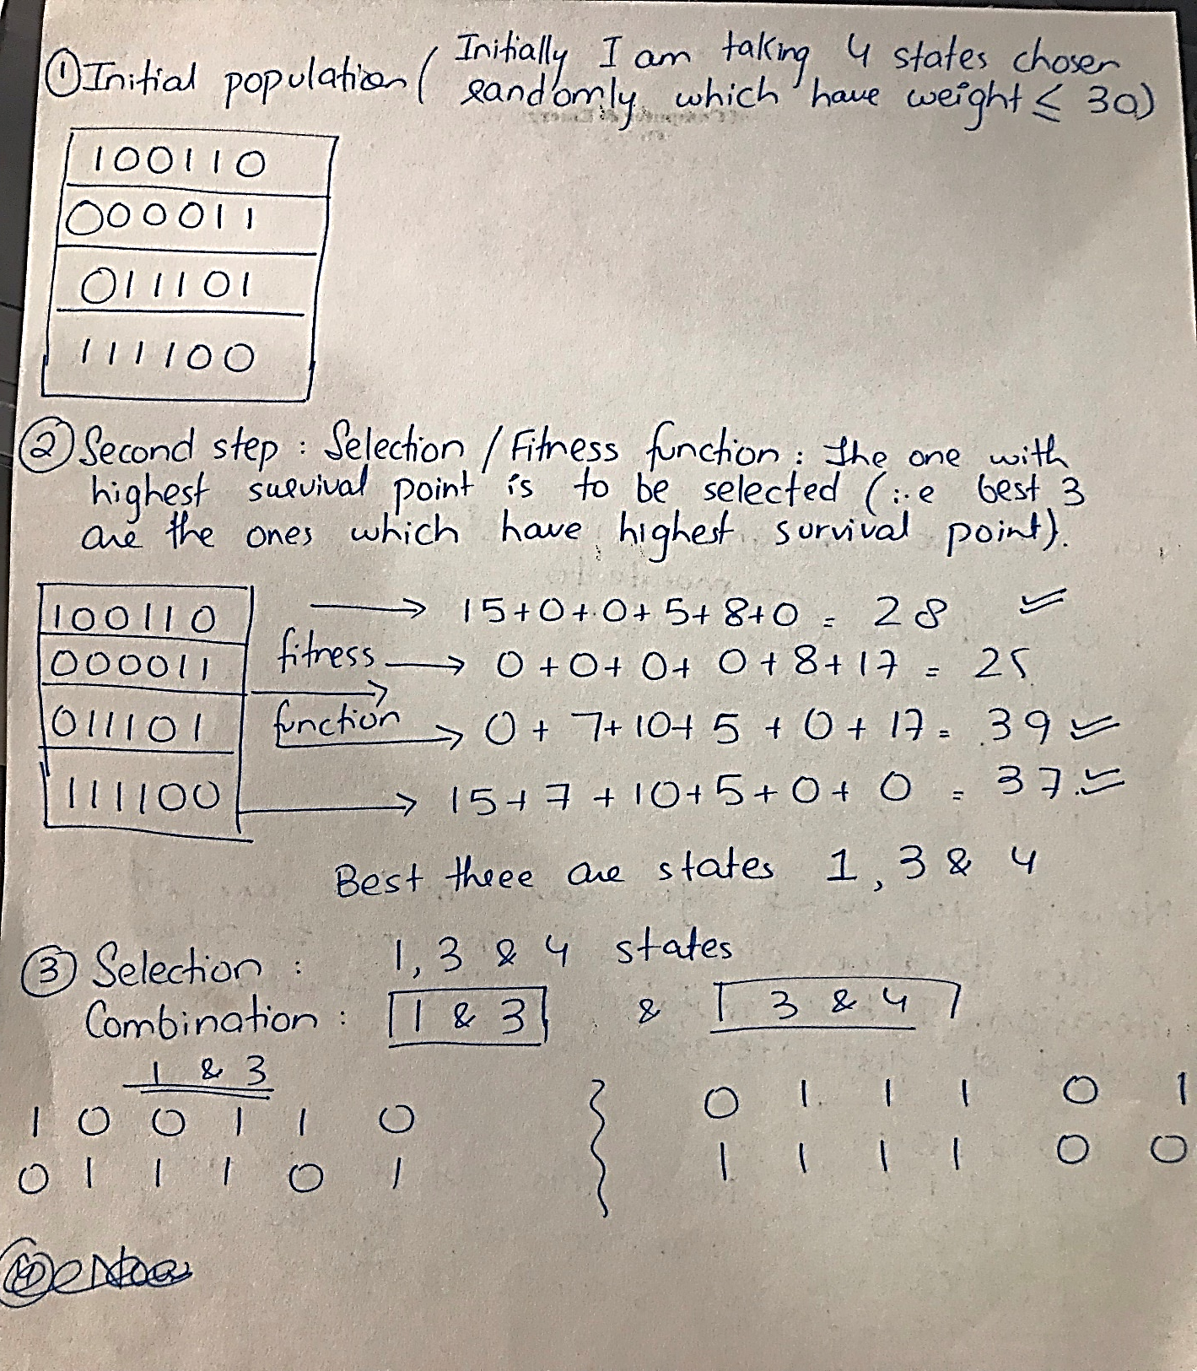

Slide 31
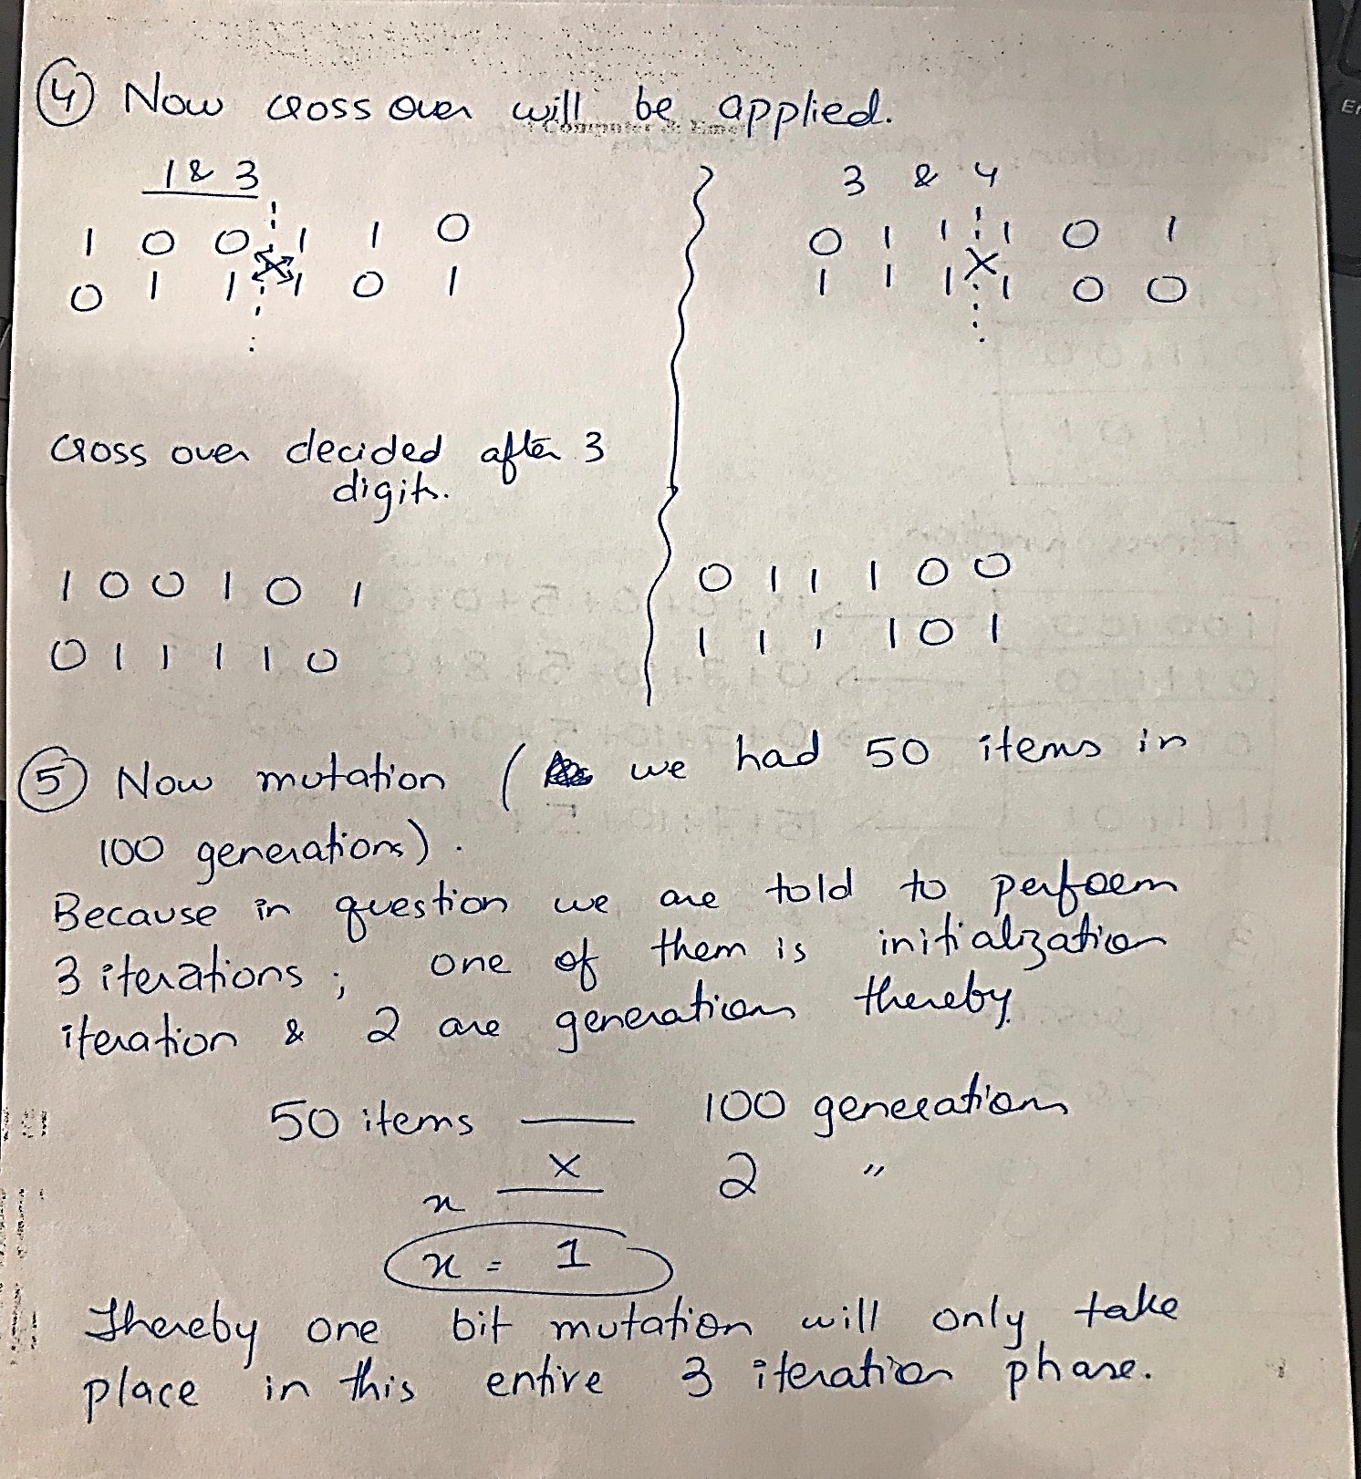

Slide 32
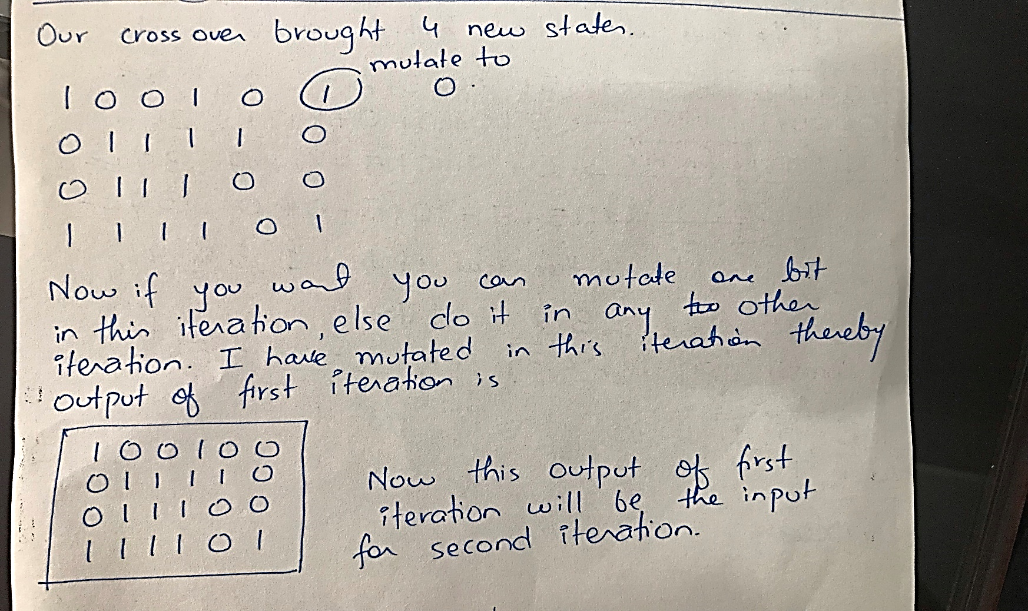

Slide 33
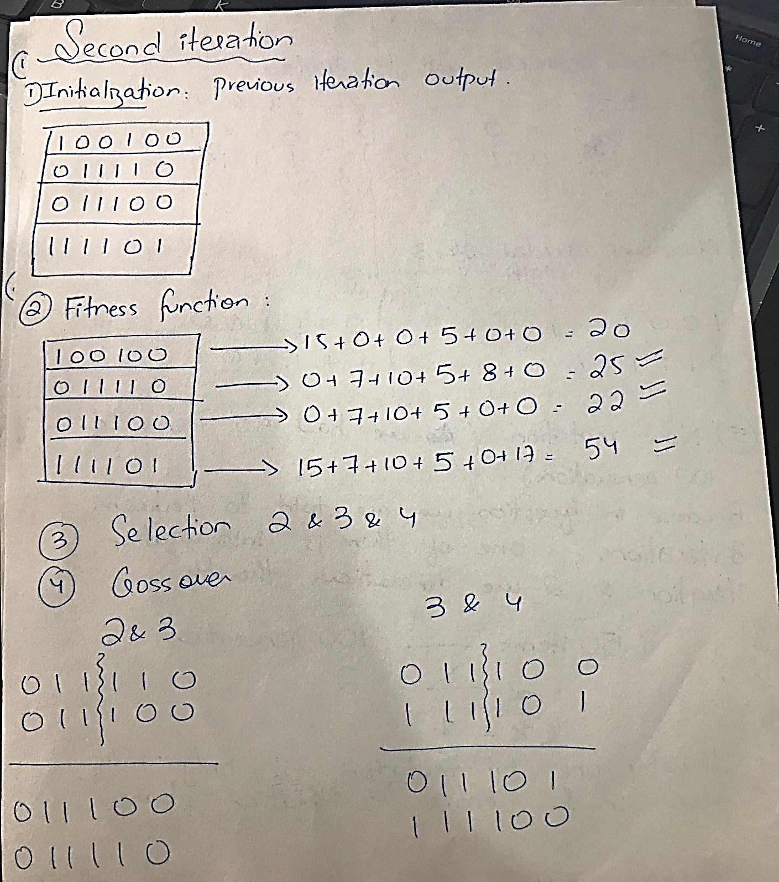

Slide 34
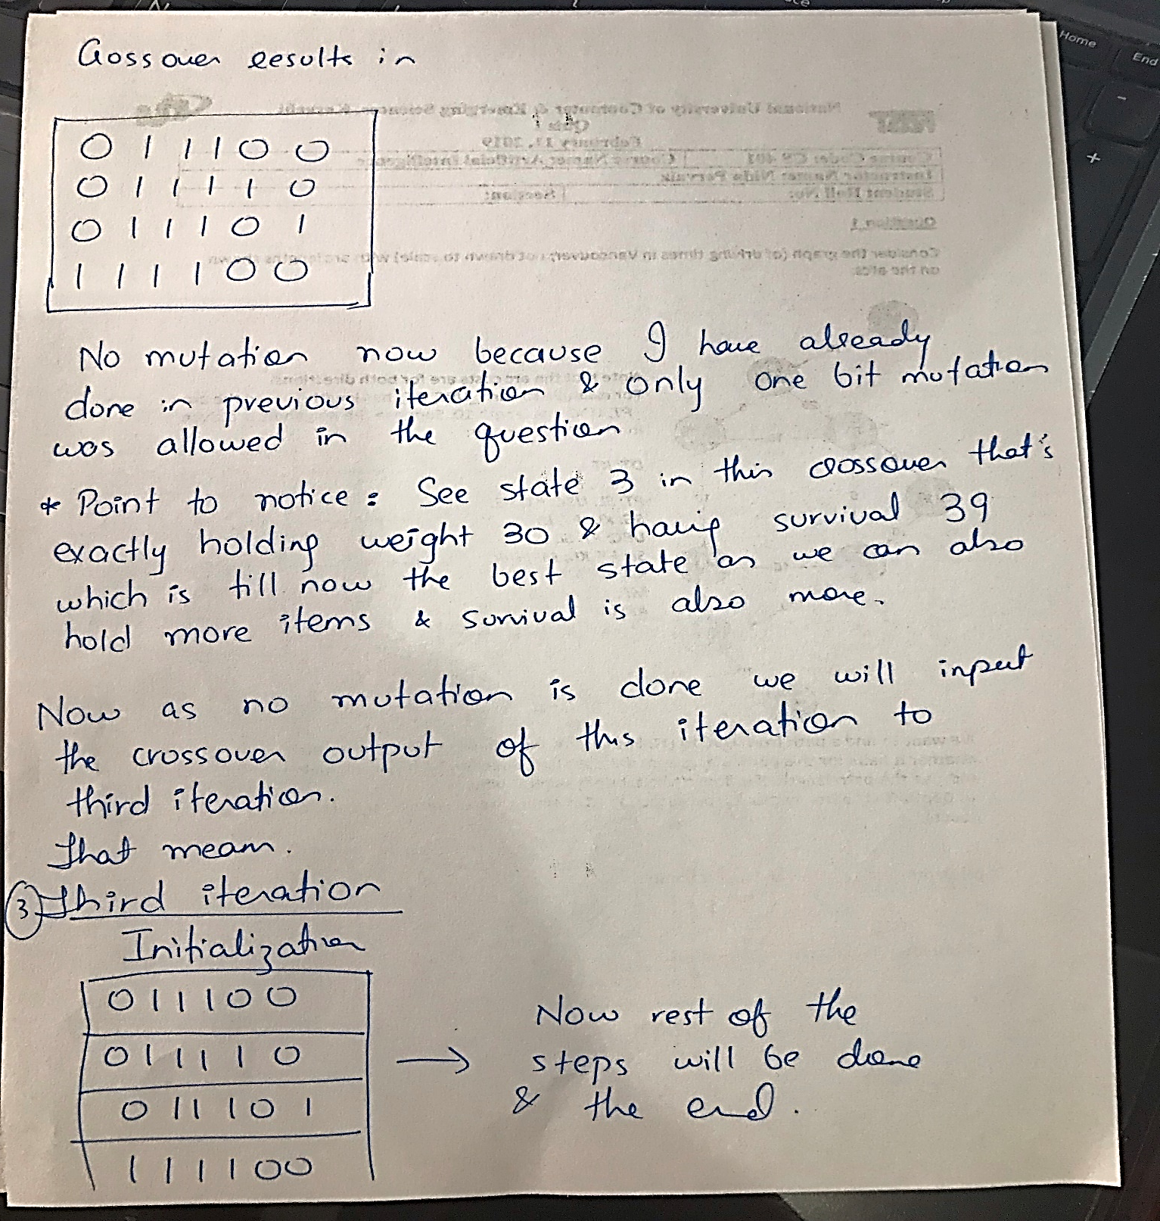
You can do the third iteration on your own now. First two iterations have been done by me.

Slide 35
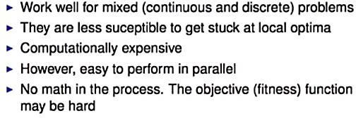
Properties

